Slide 1
Detection of Insider Threat Behavior Patterns: A Data Driven Approach Using Power BI
Submitted in the partial fulfillment for the award of the degree of
BACHELOR OF ENGINEERING
IN
CSE(INFORMATION SECURITY)
Submitted by:
SHUBAHM PATEL(22BIS50002)
LALIT(22BIS50004)
SHASHWAT SHARMA(22BIS50005)
Under the Supervision of:
Sheetal Laroiya
Department of AIT-CSE
DISCOVER . LEARN . EMPOWER

Slide 2
Outline
Introduction
Objective
Methodology

Slide 3
Introduction
Insider Threat refers to security risks originating from individuals within an organization (employees, contractors, partners).
These threats can be malicious (intentional data theft, sabotage) or negligent (careless handling of sensitive data).
Traditional security systems often focus on external attacks, leaving insider threats under-monitored.
With the growth of data-driven decision-making, analyzing user behavior patterns can significantly improve threat detection.

Slide 4
Project Overview
Objective: Identify unusual or risky insider activities by leveraging data analytics and visualization.
Approach:
  Collect logs from internal systems (e.g., access logs, file usage, login times).
  Apply data preprocessing to identify key indicators of suspicious behavior.
  Use Power BI dashboards for real-time visualization and pattern recognition.
Benefits:
  Early detection of potential threats.
  Actionable insights for security teams.
  Improved compliance and reduced data breach risks.

Slide 5
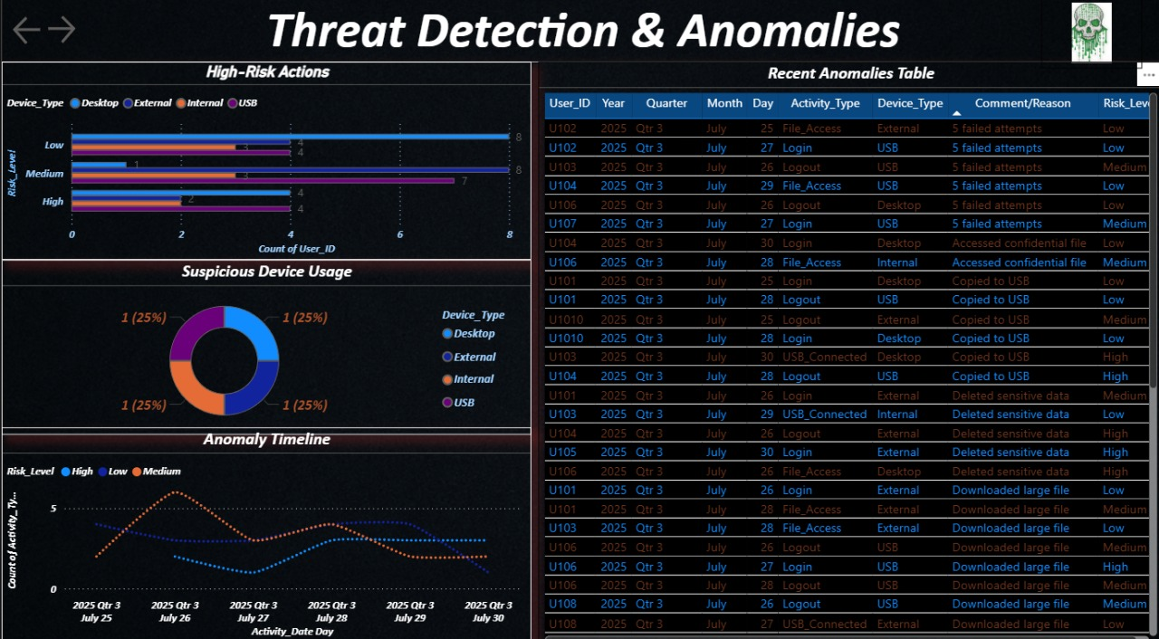
Project Overview

Slide 6
Methodology used
  Step 1: Data Collection
  Gather logs from multiple internal sources:
    Operating system(Windows Event Viewer , Linux /var/log/).
    Application & database (web server logs, DB query logs).
    Network devices(router, firewall, switch Syslog).
    Cloud services(AWS, Azure, Microsoft 365 audit logs).
    User Login/logout records, file access history, email/messaging patterns.
Step 2: Data Preprocessing
    Remove duplicate/irrelevant records
    Handle missing values and normalize data formats
    Convert timestamps into meaningful segments (e.g., working hours vs. odd hours)

Slide 7
Methodology used
Step 3: Feature Extraction
Identify Key Behavioral Indicators (KBIs) such as:
  Unusual login times
  Excessive data downloads
  Access to restricted files
  Abnormal network traffic patterns
Step 4: Data Integration into Power BI
  Import cleaned datasets (CSV/JSON/Database) into Power BI
  Establish relationships between multiple log sources
  Enable scheduled data refresh for updated insights

Slide 8
Methodology used
Step 5: Visualization & Pattern Detection
  Create interactive dashboards for real-time monitoring
  Use charts, heatmaps, and anomaly detection visuals to highlight risky behaviors
Step 6: Insight Generation & Reporting
  Detect unusual activity patterns through visual trends
  Generate automated alerts for high-risk activities
  Provide actionable reports for security teams to investigate

Slide 9
Thankyou

